Slide 1
Sustainable Marketing Plan
Brittany Brock, Wes Davic, Grant Panko, Mitch Obenrader

Slide 2
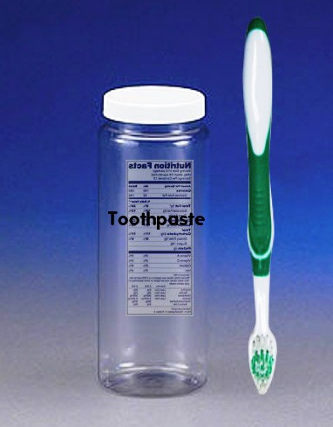
Our Product

Slide 3
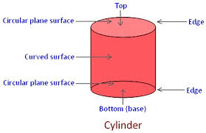
Description
Cylinder shaped container
Flexible material to squeeze toothpaste
Removable lid to access paste
Ability to scrape sides of container
Decrease product waste
Safety seal for packaging

Slide 4
Background & Target Market
Anyone who wants clean teeth
Typical waste on traditional pouch, once it’s out it’s out
Cylinder provides more product and zero waste
Reduce material usage and save customer money in years to come
No one likes spending money on toiletries Reduce our carbon footprint with less trucks on the road

Slide 5
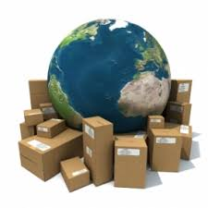
Distribution Plan
Online
Reach broad customer base
Allows for customer contact
All revenue is for the company
Wholesaler
Use when more established
Reach large market
Focus on our product

Slide 6
Pricing
$4.50 for one tube 10.4 ounces compared to Crest and Colgate $3.00 for 6.4 ounces
Unit Price is better and you get more per portion
Saves you hassle from driving to the store at night
No wasted product
$2.75 for 6.4 ounces or $16.00 for 12 ounces of 3D White Brillance
We want to put more product in at a less price

Slide 7
Promotional Plan
Social media
Use other accounts as a form of free advertising
Public promotional idea
Table with samples
Pamphlets with facts
Offer incentives for advertising and data

Slide 8
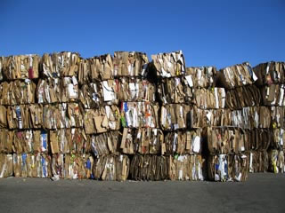
Impact on Sustainability
Packageless
Can ship more cylindrical tubes than square on one truck
Saves thousands of gallons of ink from being used on cardboard
Saves millions of pounds of paper

