Slide 1
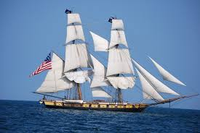
Flagship Niagara League

Slide 2
Focus: Increase Memberships
Target: Families & Grandparents
Primary Research: Focus Groups &
Personal Interviews
Results ~
Increase Community Awareness
Add Value To Membership
Additions To Museum

Slide 3
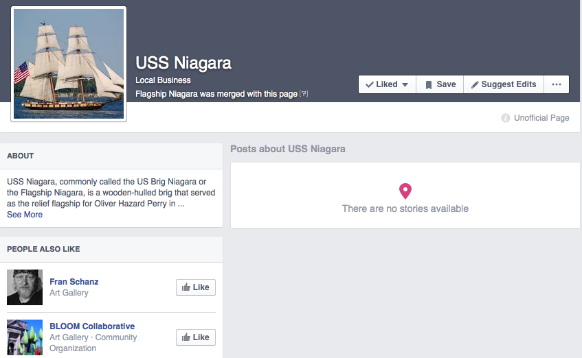
Facebook

Slide 4
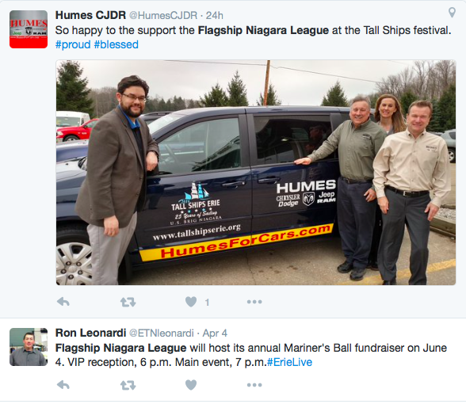
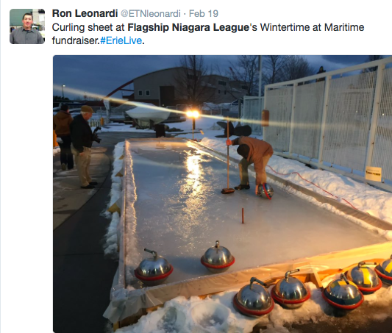
Twitter

Slide 5
Short Term Strategy
Hire a marketing specialist ~
Make It Great Media
www.makeitgreatmedia.com
Services ~ Ben Henry ~ Co Founder
Posting/managing social media sites
Create fun & creative YouTube videos
Go out into the community & gather partnerships/promote organization
Ex: Juice Jar
Notes:
** Need to update the museum- seasonally.

Slide 6
Contact: Prashant → support@avalonsolution.com
Services ~
Monthly E-blasts
(includes artwork, linkage, & program to store emails)
Website Control & Design

Slide 7
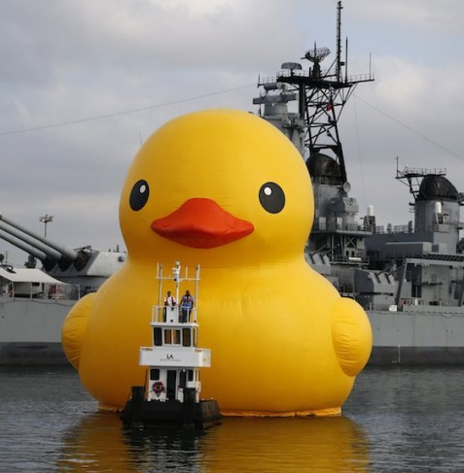

Slide 8
Long Term Strategy
Maritime Membership Card
Build long term partnerships through membership card.
Members receive ½ off access to these destinations.
Builds organization awareness & develops deeper roots with the Erie community. Gives another incentive to visit and purchase membership

Slide 9
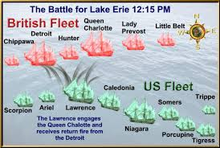
Long Term Strategy
Add a War Table.
Show logistics of battle (who was involved). Show strategic positions and highlight Oliver Perry’s jump from the Lawrence to the Niagara in the midst of battle.

Slide 10
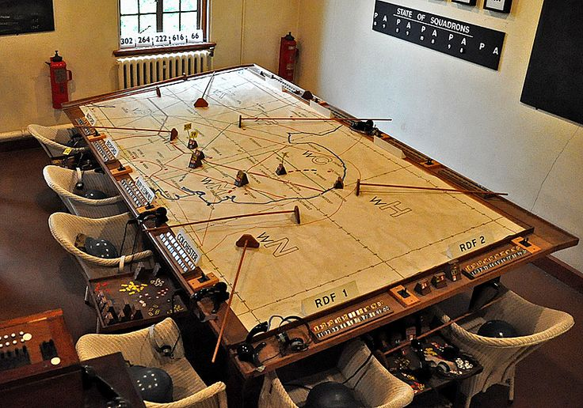
War Table
High detailed map of Lake Erie
Discuss why it was a military advantage to control the lake.
Show the tactics that both sides conducted during battle
Get your audience excited, this is a major part of this city’s history
Paint that picture

Slide 11
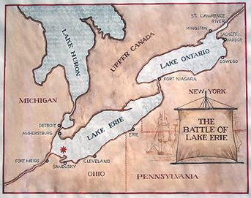
Benefits
Draws a crowd like IMAX theaters
Entertaining for all ages
Utilizes staff’s expertise to the fullest possibility
Can be built internally for next to nothing
Creates the air of importance around the Niagara vessel, creating a better tour experience
A win-win

Slide 12
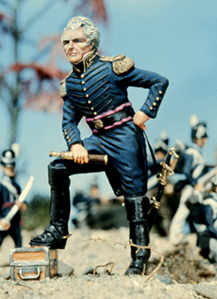
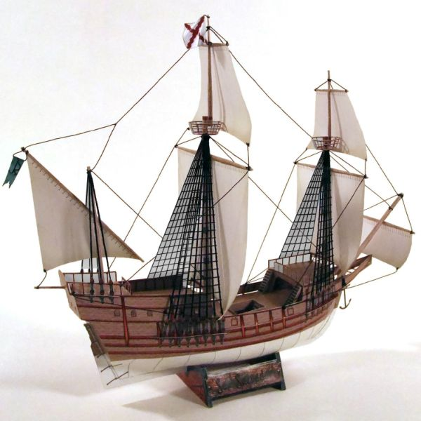
Pieces
Be creative
Pieces range from $2.99-$19.99 depending on detail.
These basic miniatures cost $4.99 and $6.99 respectively.
Mold it into your own experience.
Kids want to see 3D toys on the table not imagine it.
Adults want to see a representation of what it truly was.
Most people learn through visuals and not explanations.

Slide 13
Additional Thoughts
Relics and artifacts in the museum are great already, more could not hurt
Update the sound system so people feel more into what is playing on screen
Add more interactive exhibits like the knot tying one for families
Update historic videos with high quality stock footage

Slide 14
Summary
Short Term
Enhance exposure on social media.
Hire a second marketing specialist.
Utilize e-mailing through Avalon Solutions
Long Term
Create a Maritime Membership Card
Create a War Table

Slide 15
Thank you
We will now accept questions.

