Slide 1
Erie Times News Showcase
Joseph Neff, Grant Panko

Slide 2
What the study was about
Is Erie Times News still relevant to the community that they are targeting and, if any, what changes should they need to make to stay relevant?
Notes:
The main question Amanda Ferrell asked us about was if

Slide 3
Literature Review
What is a millennial
How millennials consume news
Notes:
Defined as the demographic between the 1980’s and 2000’s. Millennials are known for their social activity through the internet and social media websites. Known to consume news through multiple platforms, but social media sites are the main sources millennials pay attention to.

Slide 4
Focus Group
Consisted of six college millennials
How they obtain and share news
What influences their social connectivity
Notes:
The focus group we conducted consisted of six college millennials, all studying different majors. Throughout the duration of the experiment we found out that college students like to do activities with their friends. The information that we found led us to believe that millennials like to be connected with each other through media at all times and because of this, they are able to obtain and share news faster than any other demographic.

Slide 5
Online survey
228 results
Print vs Digital
Readership increases when content is created by friends and family
Readership increase with sense of community
Print readership increase with active online presence
Notes:
The survey consisted of 228 participants. The results measured erie readership preference of digital vs print, weather friends and family being on social media affects social activity, and if print readership increases with an active online presence.

Slide 6
Analysis and Results
Hypothesis
H1: (a) Publishing on social media platforms increases readership (b) Publishing on Facebook increases readership more than publishing on any other social platform (DIGITAL PLATFORM)
H2: (a) Readership increases if they have the knowledge of their friends and peers read them (b) Readership increases if the news engages them (c) Readership increases when the content is created by those they perceive to be their peers (PEER EFFECT)
H3: Readership increases if sense of community is communicated through content (SENSE OF COMMUNITY)
H4: Print readership increases with an active online readership
Notes:
H1: (a) Publishing on social media platforms increases readership (b) Publishing on Facebook increases readership more than publishing on any other social platform (DIGITAL PLATFORM)
H2: (a) Readership increases if they have the knowledge of their friends and peers read them (b) Readership increases if the news engages them (c) Readership increases when the content is created by those they perceive to be their peers (PEER EFFECT)
H3: Readership increases if sense of community is communicated through content (SENSE OF COMMUNITY)
H4: Print readership increases with an active online readership

Slide 7
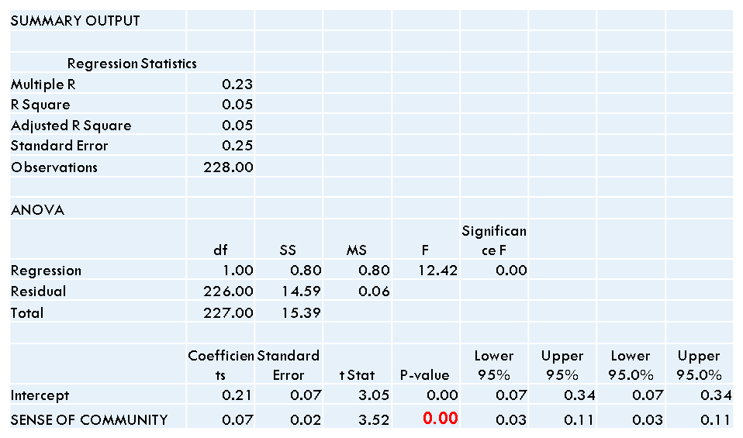
Sense of Community on Digital Readership
Notes:
Sense of community affects digital readership in a significant way. People enjoy being included and a part of something. When they see friends or family posting things online, they are more likely to read them and post the stories or activites for themselves.

Slide 8
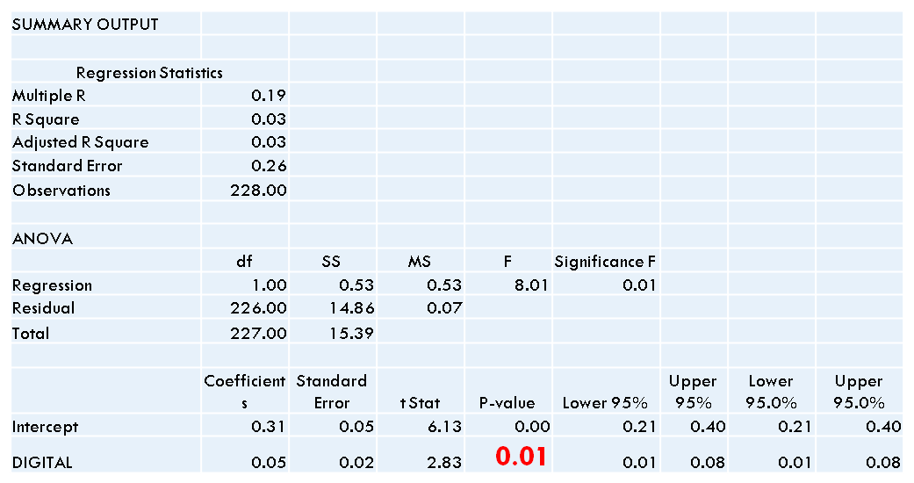
Digital Platforms affect on Digital Readership
Notes:
If the information is available on more than one digital platform, own website, twitter, facebook, more likely for people to see it. With it being seen more, this will expose it to more people, creating more digital readership along with it.

Slide 9
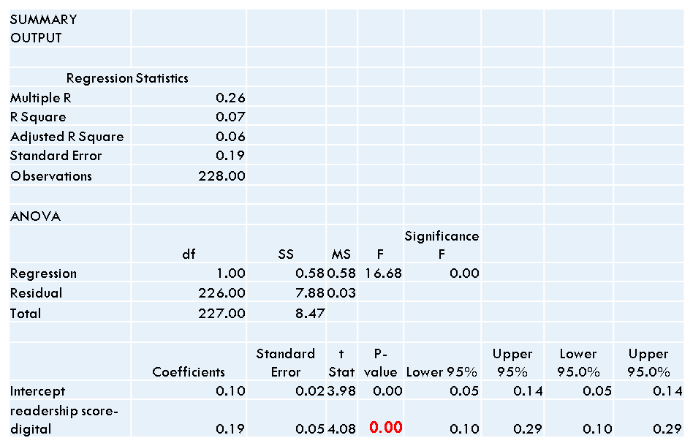
Digital Readership increases Print Readership
Notes:
digital readership also affects print readership. the more people are exposed to digital platforms, the more likely they are to read digital stories. when reading digital stories, it makes them more likely to be intruiged by what they are reading and seeing to go and pick up a print newspaper.

Slide 10
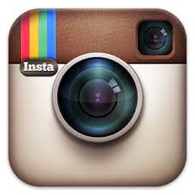
The Future of Showcase
Updated daily content
Pictures with link to story
Own Showcase account
Updated daily content
Notes:
In conclusion If Erie Time News wants to attract millennial readers, we recommend that they recreate their social media design. Our data shows that Facebook has become an app for the past, what's hot with millennials is instagram and twitter. In order to get in touch with millennials the company needs to be present and prominent on both of these platforms. Pictures, daily uploads and showcase stories that can easily read and shared to friends and family is the main attention grabber that will be used when presenting these news media methods to the millennial demographic.

