Slide 1
Edwin the Duck
Henry Compernolle, Andy Lu, Mark Massimino, Grant Panko, Alaina Randolph

Slide 2
*Edwin Lullaby Playing*

Slide 3
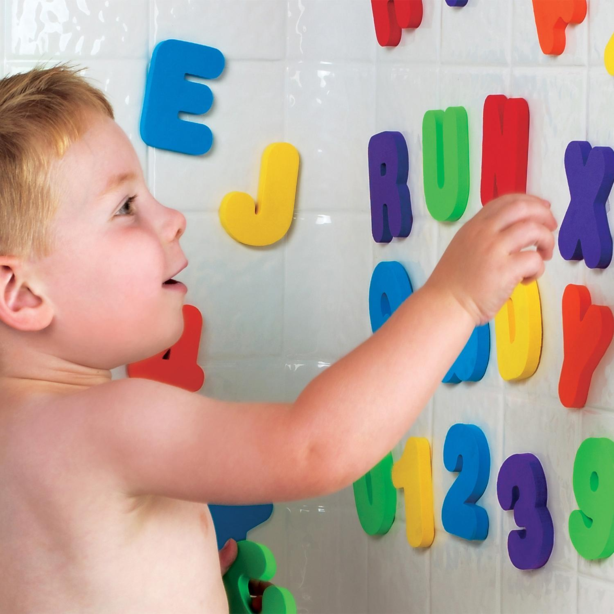
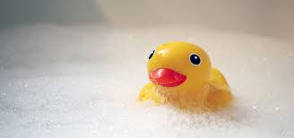
s
EDWIN

Slide 4
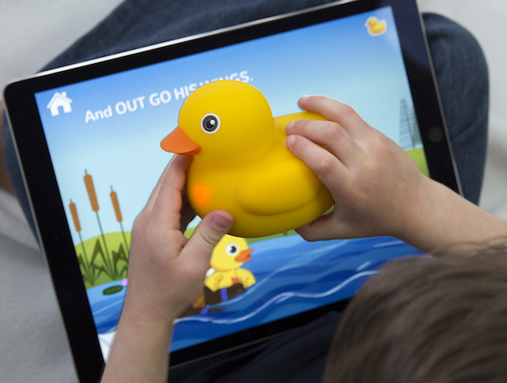

Slide 5
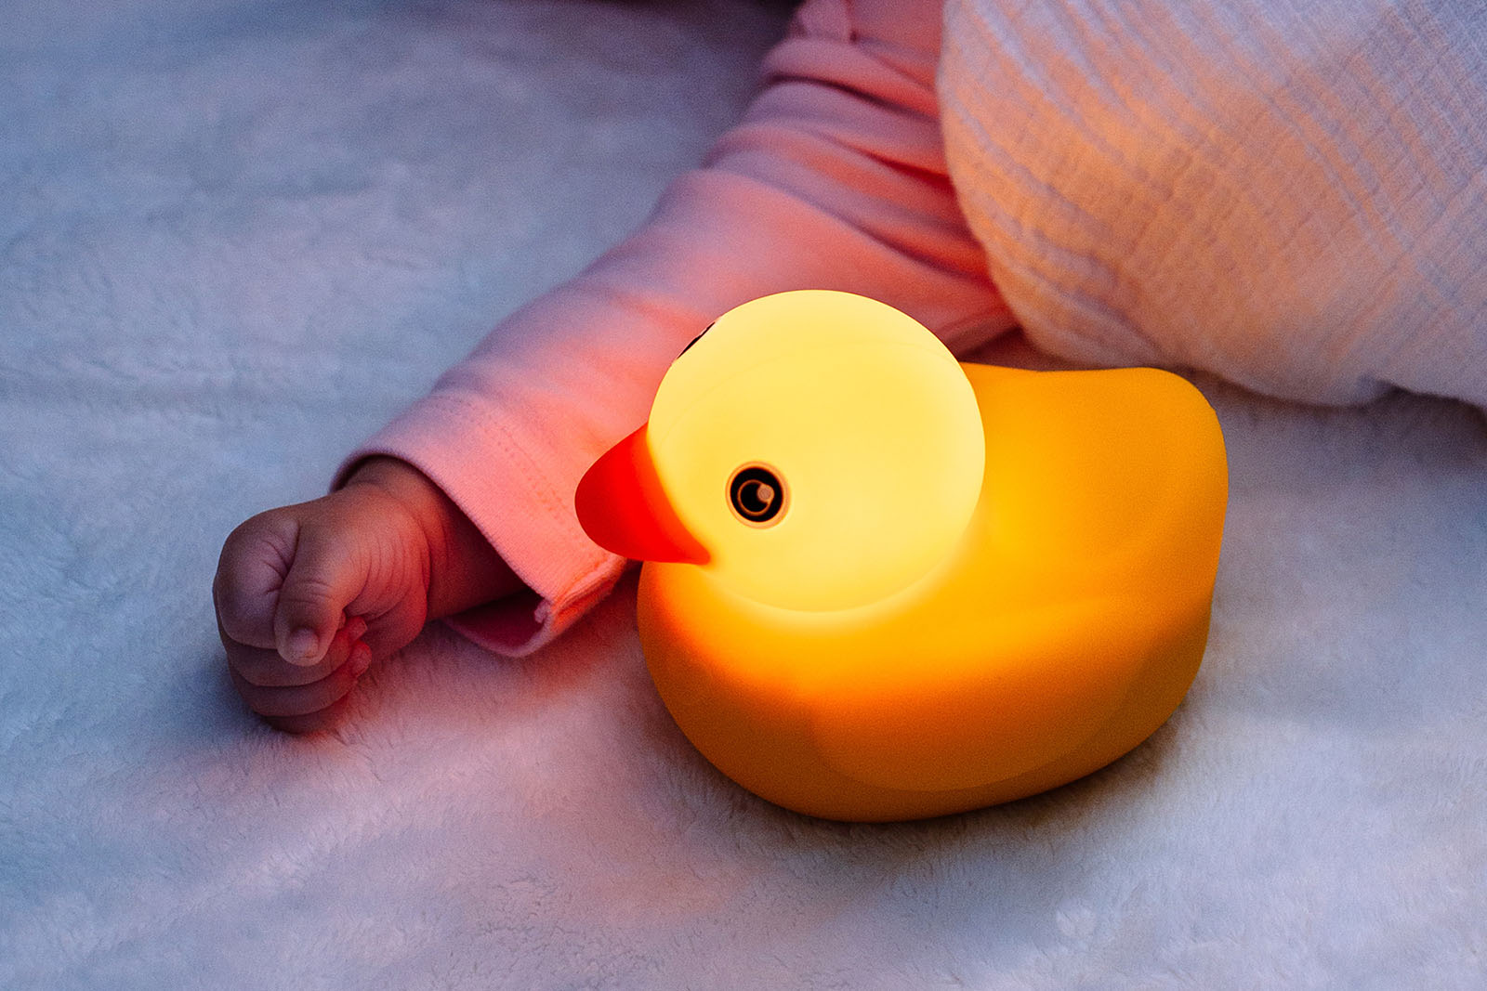
“Edwin’s Always There”

