Slide 1
Digby
Board Of Directors
FY 2021

Slide 2
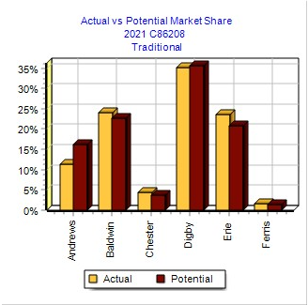
Firm Overview
Highlights
Low End and Traditional
Detractors
Debt - emergency loans
Net Loss
Over production - storage fees, TQM and HR investment
Room For Improvement
Balance Score Card
Current score : 68/100

Slide 3
Corporate Mission and Goals
Create sensors for safety and technology serving OEM’s in transportation
Beginning
Be best in the industry
Result
We are still best overall on the BSC but we are are not this round
Now
Turn the BSC around

Slide 4
Business Definition
Currently in all segments (Traditional, Low End, High End, Performance, Size)
2 products in Low End and High End

Slide 5
Current Statistics
Operations
100% average plant utilization
Highest investment in automation and TQM in industry
Research and Development
Ideal product position
Ideal product age
Material cost
Human Resources
Max Recruiting investment
Max training
Marketing
Promo budget - $6.6 mil
Sales budget - $8.7 mil
Outside sales people - 33
Inside sales people - 37
Distributors - 27

Slide 6
Financial Summary - Yr 4
Loss of 7.355 million
TQM Investment
Inventory stock
Sales of 182.849 million
Increased by only 2 million
Could have been more but we stocked out
Market Share 19.3%
Last year we had 21.4%.
Stock out
Asset Value 184.619 million
Increase by 9.935 million
Working Capital
.414
Debt to equity Ratio
1.635
Inventory Turnover
6
Cumulative Loss of 3.191 million
Market Cap
46 Million

Slide 7
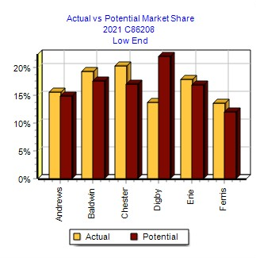
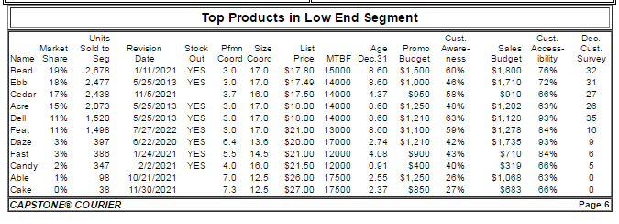
Low End - Daze and Dell
Past
Rounds 1, 2, and 3 - 4th, 2nd, and 1st in respective market share
Present
Round 4: (Current) 5th in market share (stock out)
Future
MKT - Increase spending and time allocation
Production - Produce both
R&D - Daze and Dell
Finance
NPV: $646,496.58

Slide 8
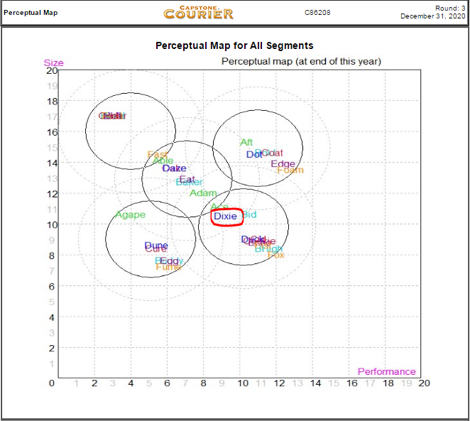
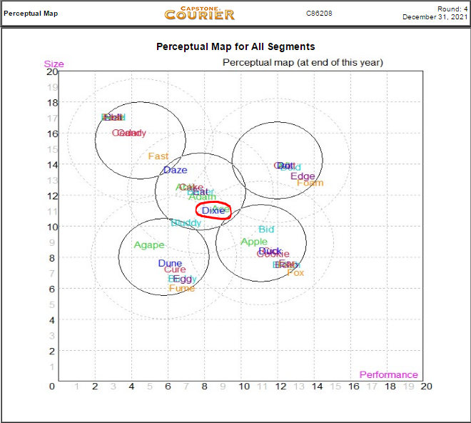
Traditional - Dixie
Past
Was Daze - Now Dixie
phase approach - lower cost strategy
Daze phased out, Dixie phased in
Present
Dixie - Traditional segment
Highest market share in the segment
Future
MKT - Invest in sales and promotions, proper time allocation
Production - Invest more in automation and TQM
R&D - Dixie stays in Traditional as well as Duck when phased in
Finance
NPV: $4,912,283.05

Slide 9
High End - Duck and Dave
Present
Dave is being researched
Invested in capacity and automation for Dave
Future
MKT
Spend effectively in promotions and sales
Increase time allocation
Production
Will invest more in Dave
R&D
Keep Dave ahead of customer needs
Begin research of a new product
Finance
NPV: $7,412,541.74

Slide 10
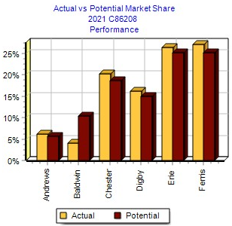
Performance - Dot
For all 4 rounds:
4th place in Performance Segment
Future expectations:
Increase market share for upcoming rounds
Future
MKT - Similar marketing budget, lower time allocation
Production - Sell as much as we produce
R&D - Adjust our performance and sizing to customer needs
NPV: $862,811.90

Slide 11
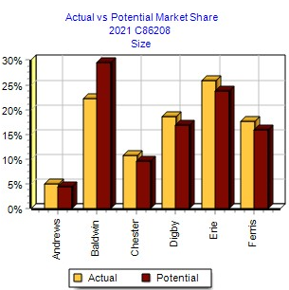
Size - Dune
Past
Round 1: 1st MKT Share
Round 2: 4th MKT Share
Round 3: 4th MKT Share
Present
Current: 3rd MKT Share
Future
MKT - similar marketing strategy, decrease time allocation
Production - Increase production of Dune
R&D - Decrease size for Dune, maintain performance
NPV: $714,263.31

Slide 12
Future Plans
Investments
TQM - Upcoming Round
NPV= $9,985,124.96
HR
NPV= $139,463.98
Corporate Strategy
Position and price each segment at or above customer expectations.
TQM and HR allows us to do this with better cost.
Operations
Better forecasting
(Next year’s segment growth rate X current round units sold) - (leftover inventory from previous round)
Ex: (1.19*10000)-1000
Notes:
Predicting market to match production: (Next year’s segment growth rate X current round units sold) - (leftover inventory from previous round)

Slide 13
Outcome
How we will finance
Debt and Retained Earnings
Value Added
Total NPV: $24,672,985.53

Slide 14
Questions and Suggestions

